Slide 1
EU-China Summer School Program 2014

Slide 2
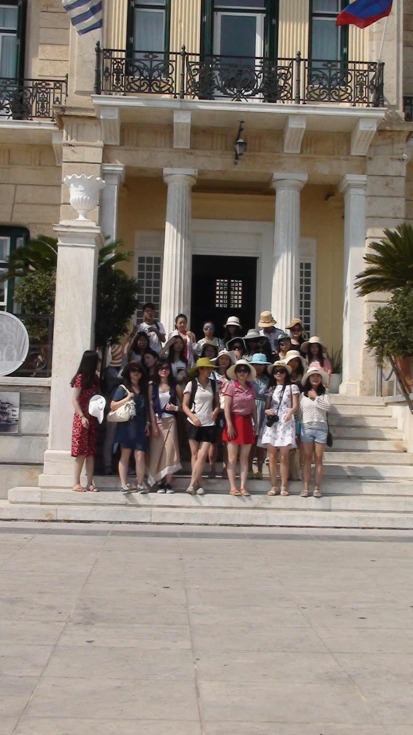
Spetses Island: In front of Posidoneum Hotel

Slide 3
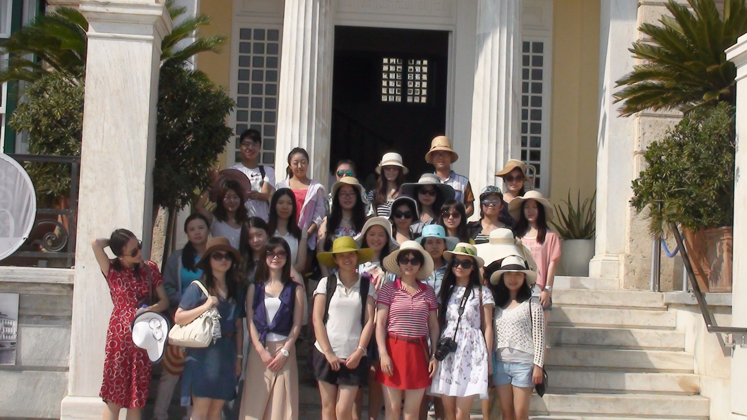
Spetses Island: In front of Posidoneum Hotel

Slide 4
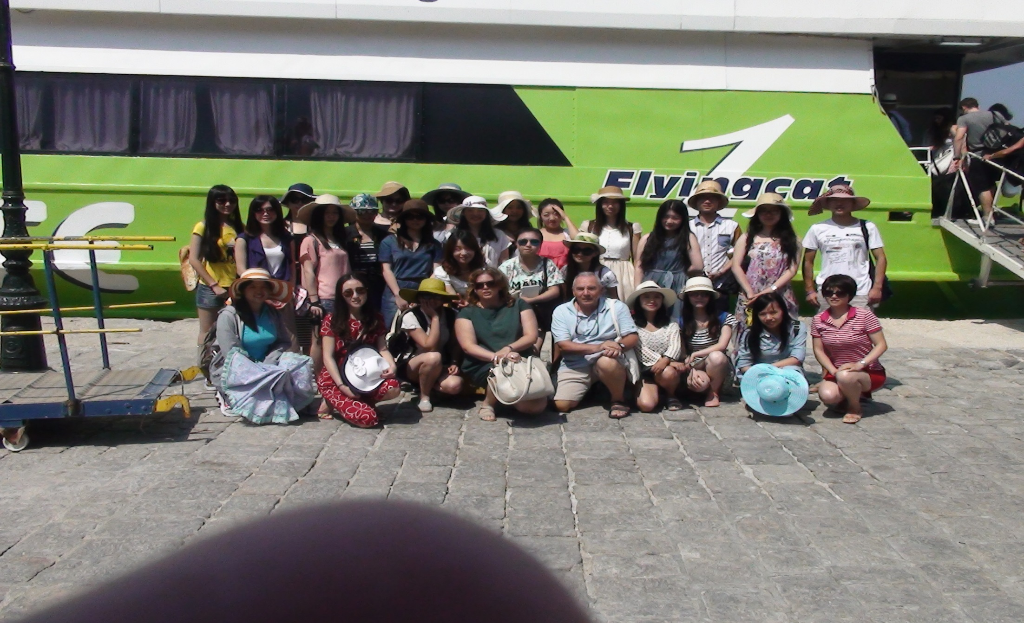
Hydra Island: Arrival

Slide 5
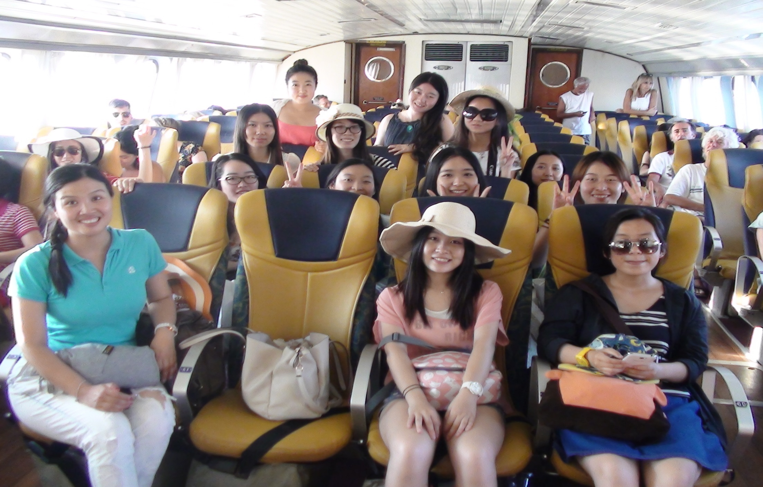
Hydra Island: Departure

Slide 6
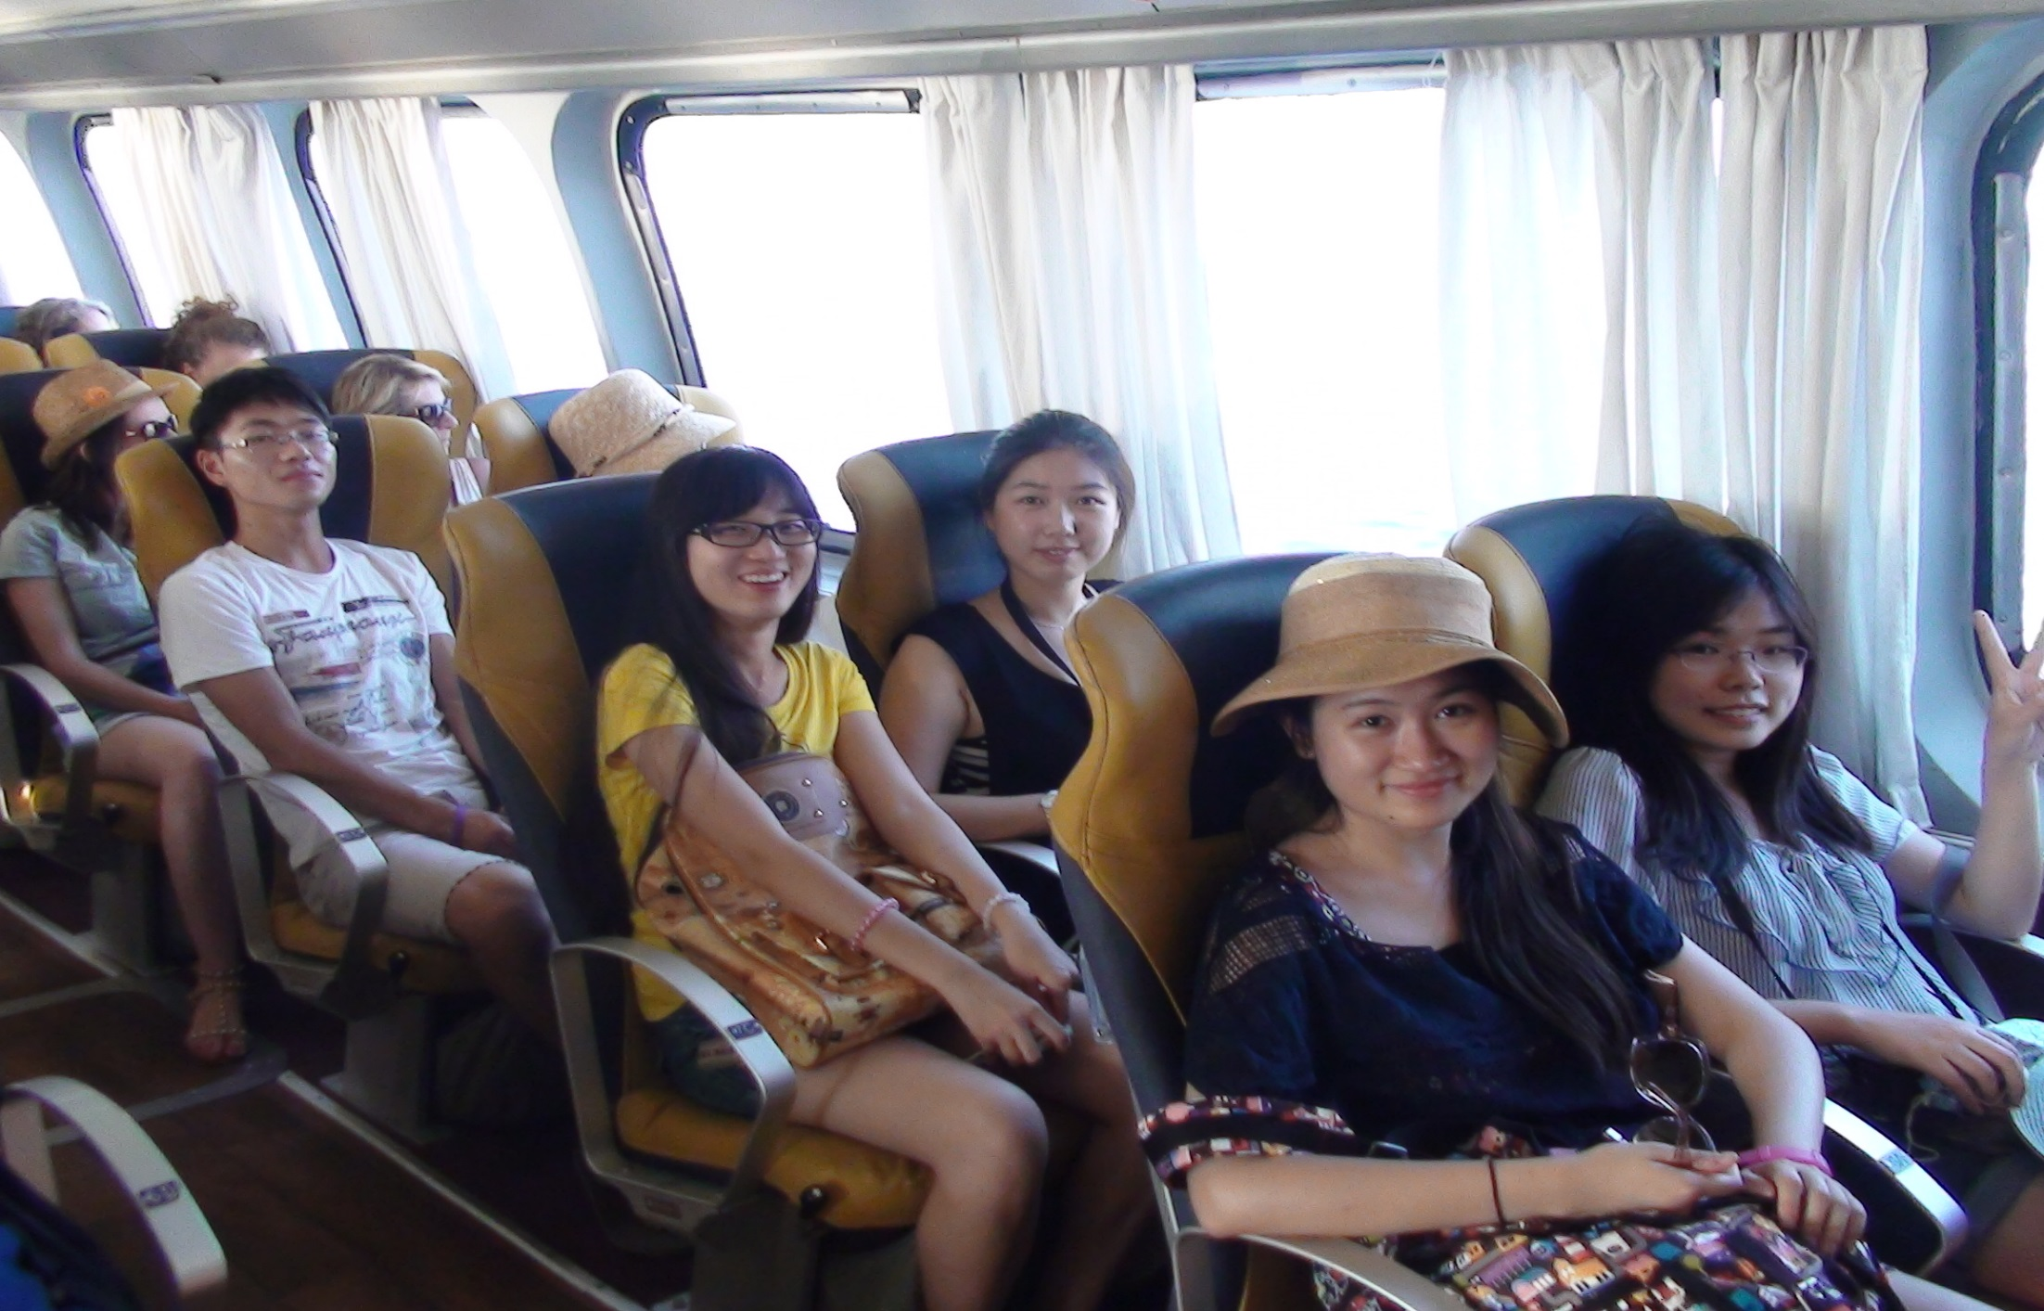
Hydra Island: Departure

Slide 7
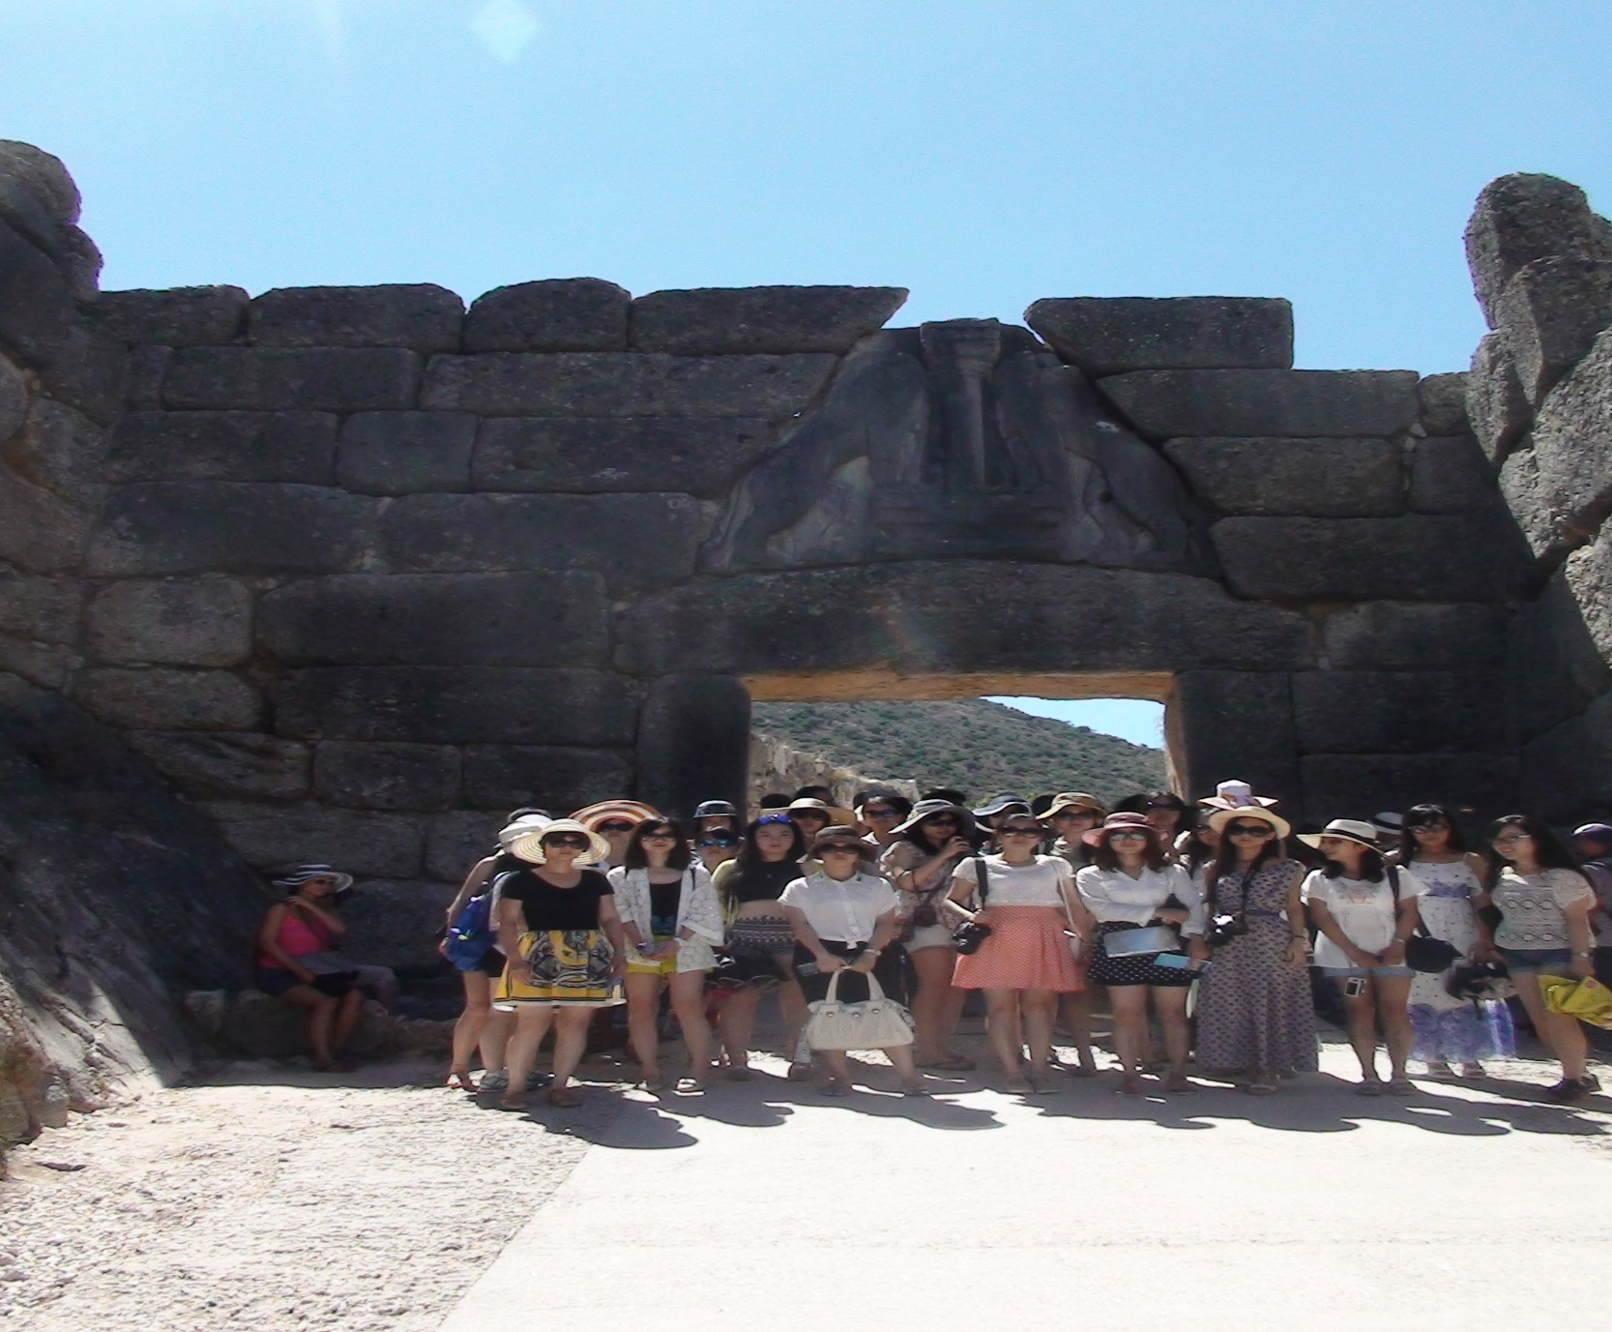
Mycenae:
Lion Gate

Slide 8
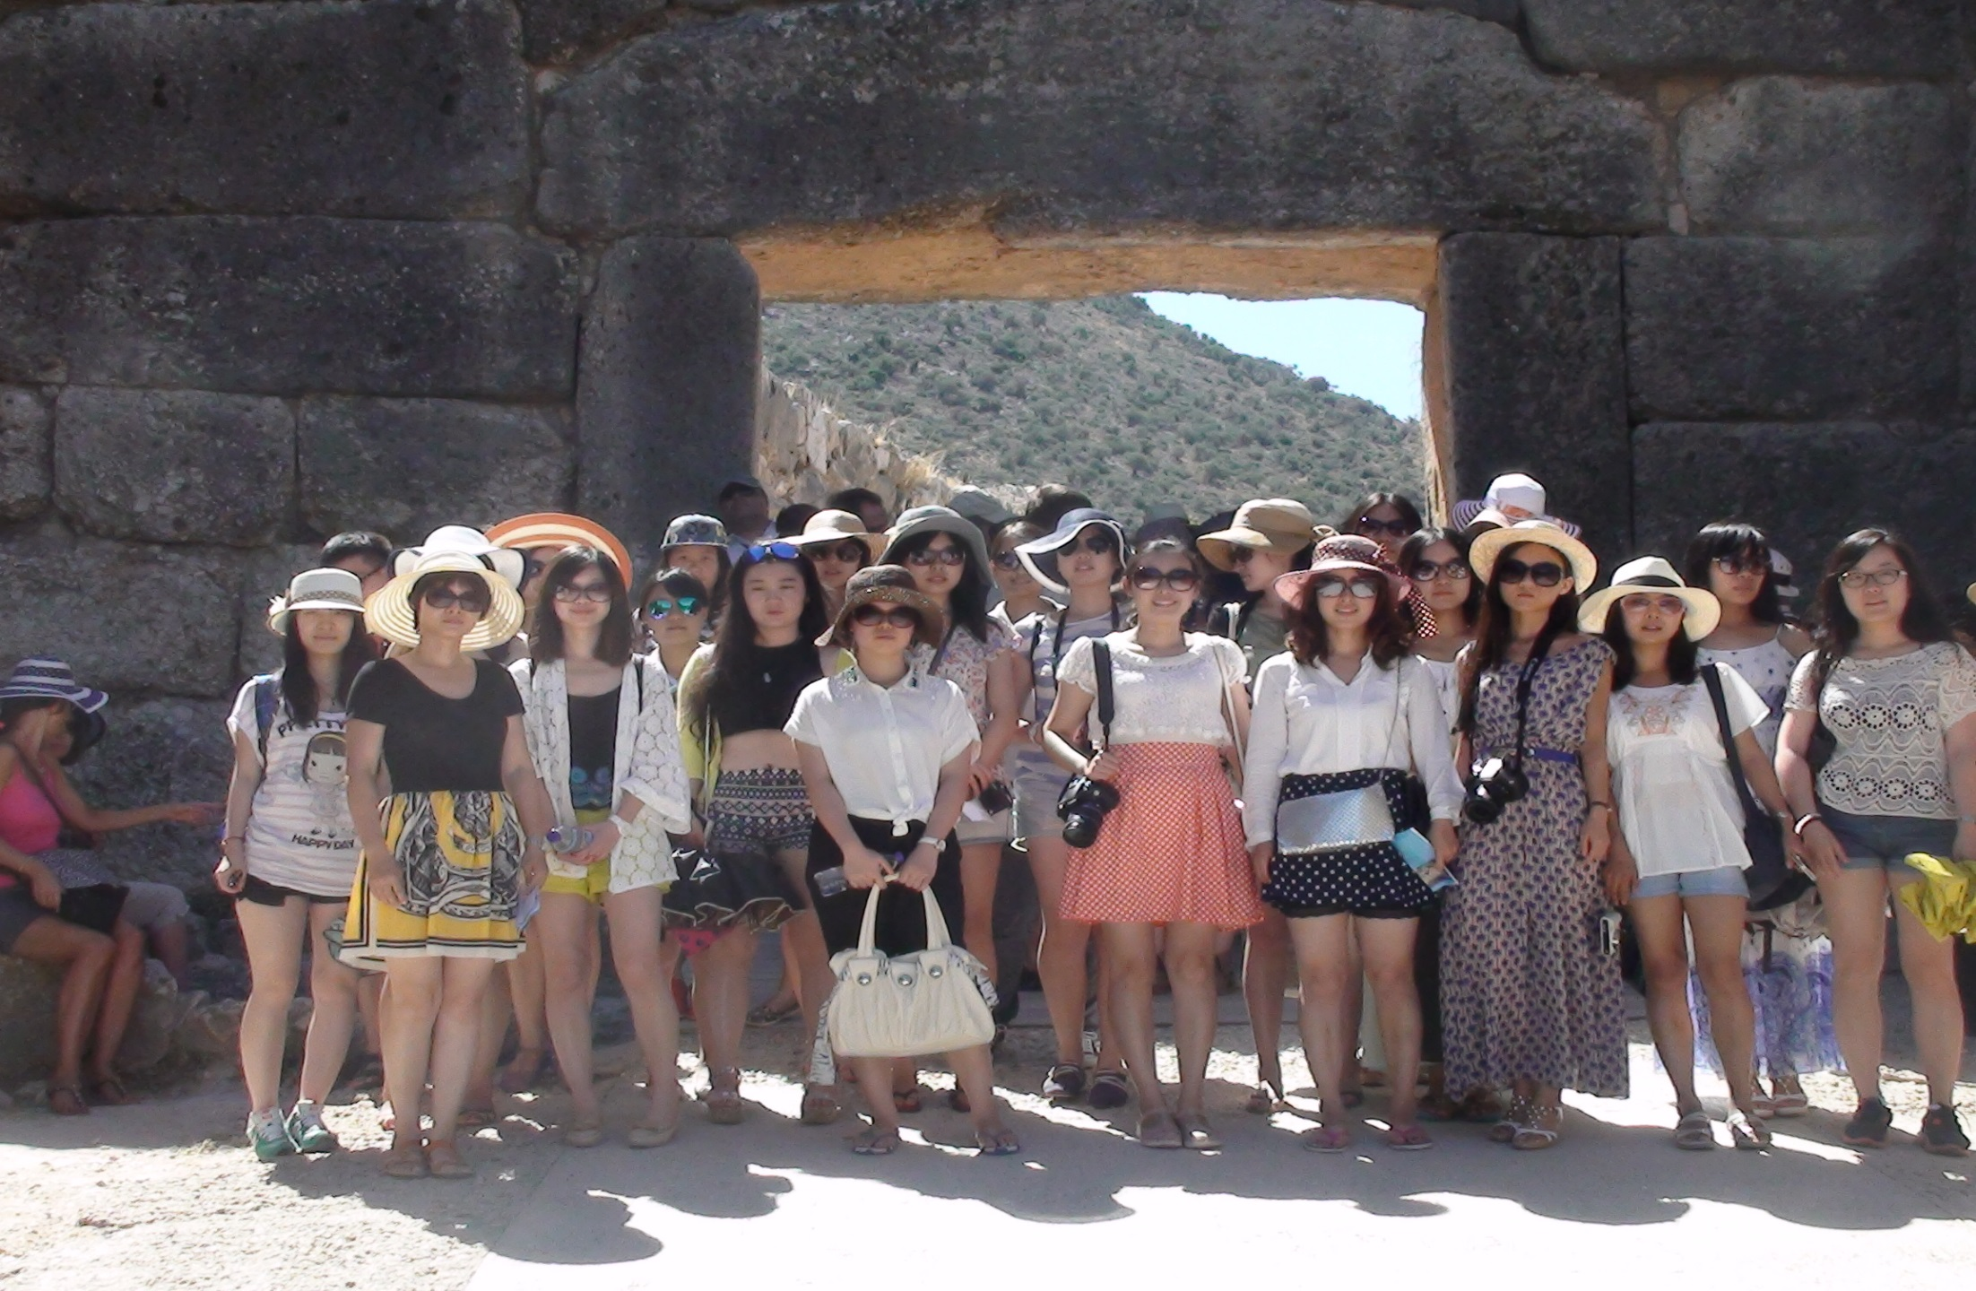
Mycenae:
Lion Gate

Slide 9
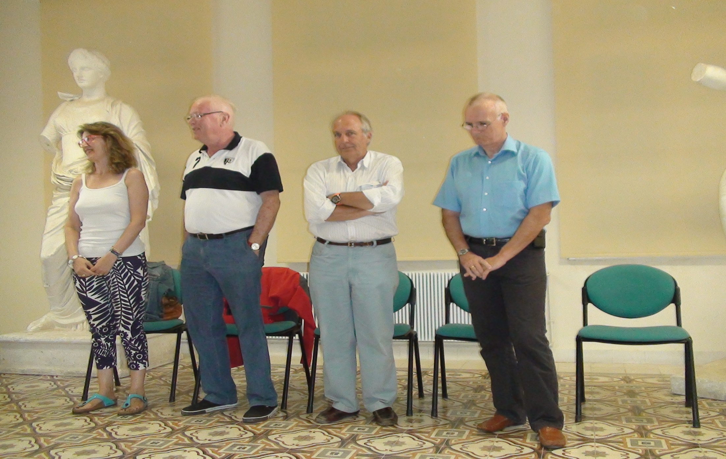
Certificates

Slide 10
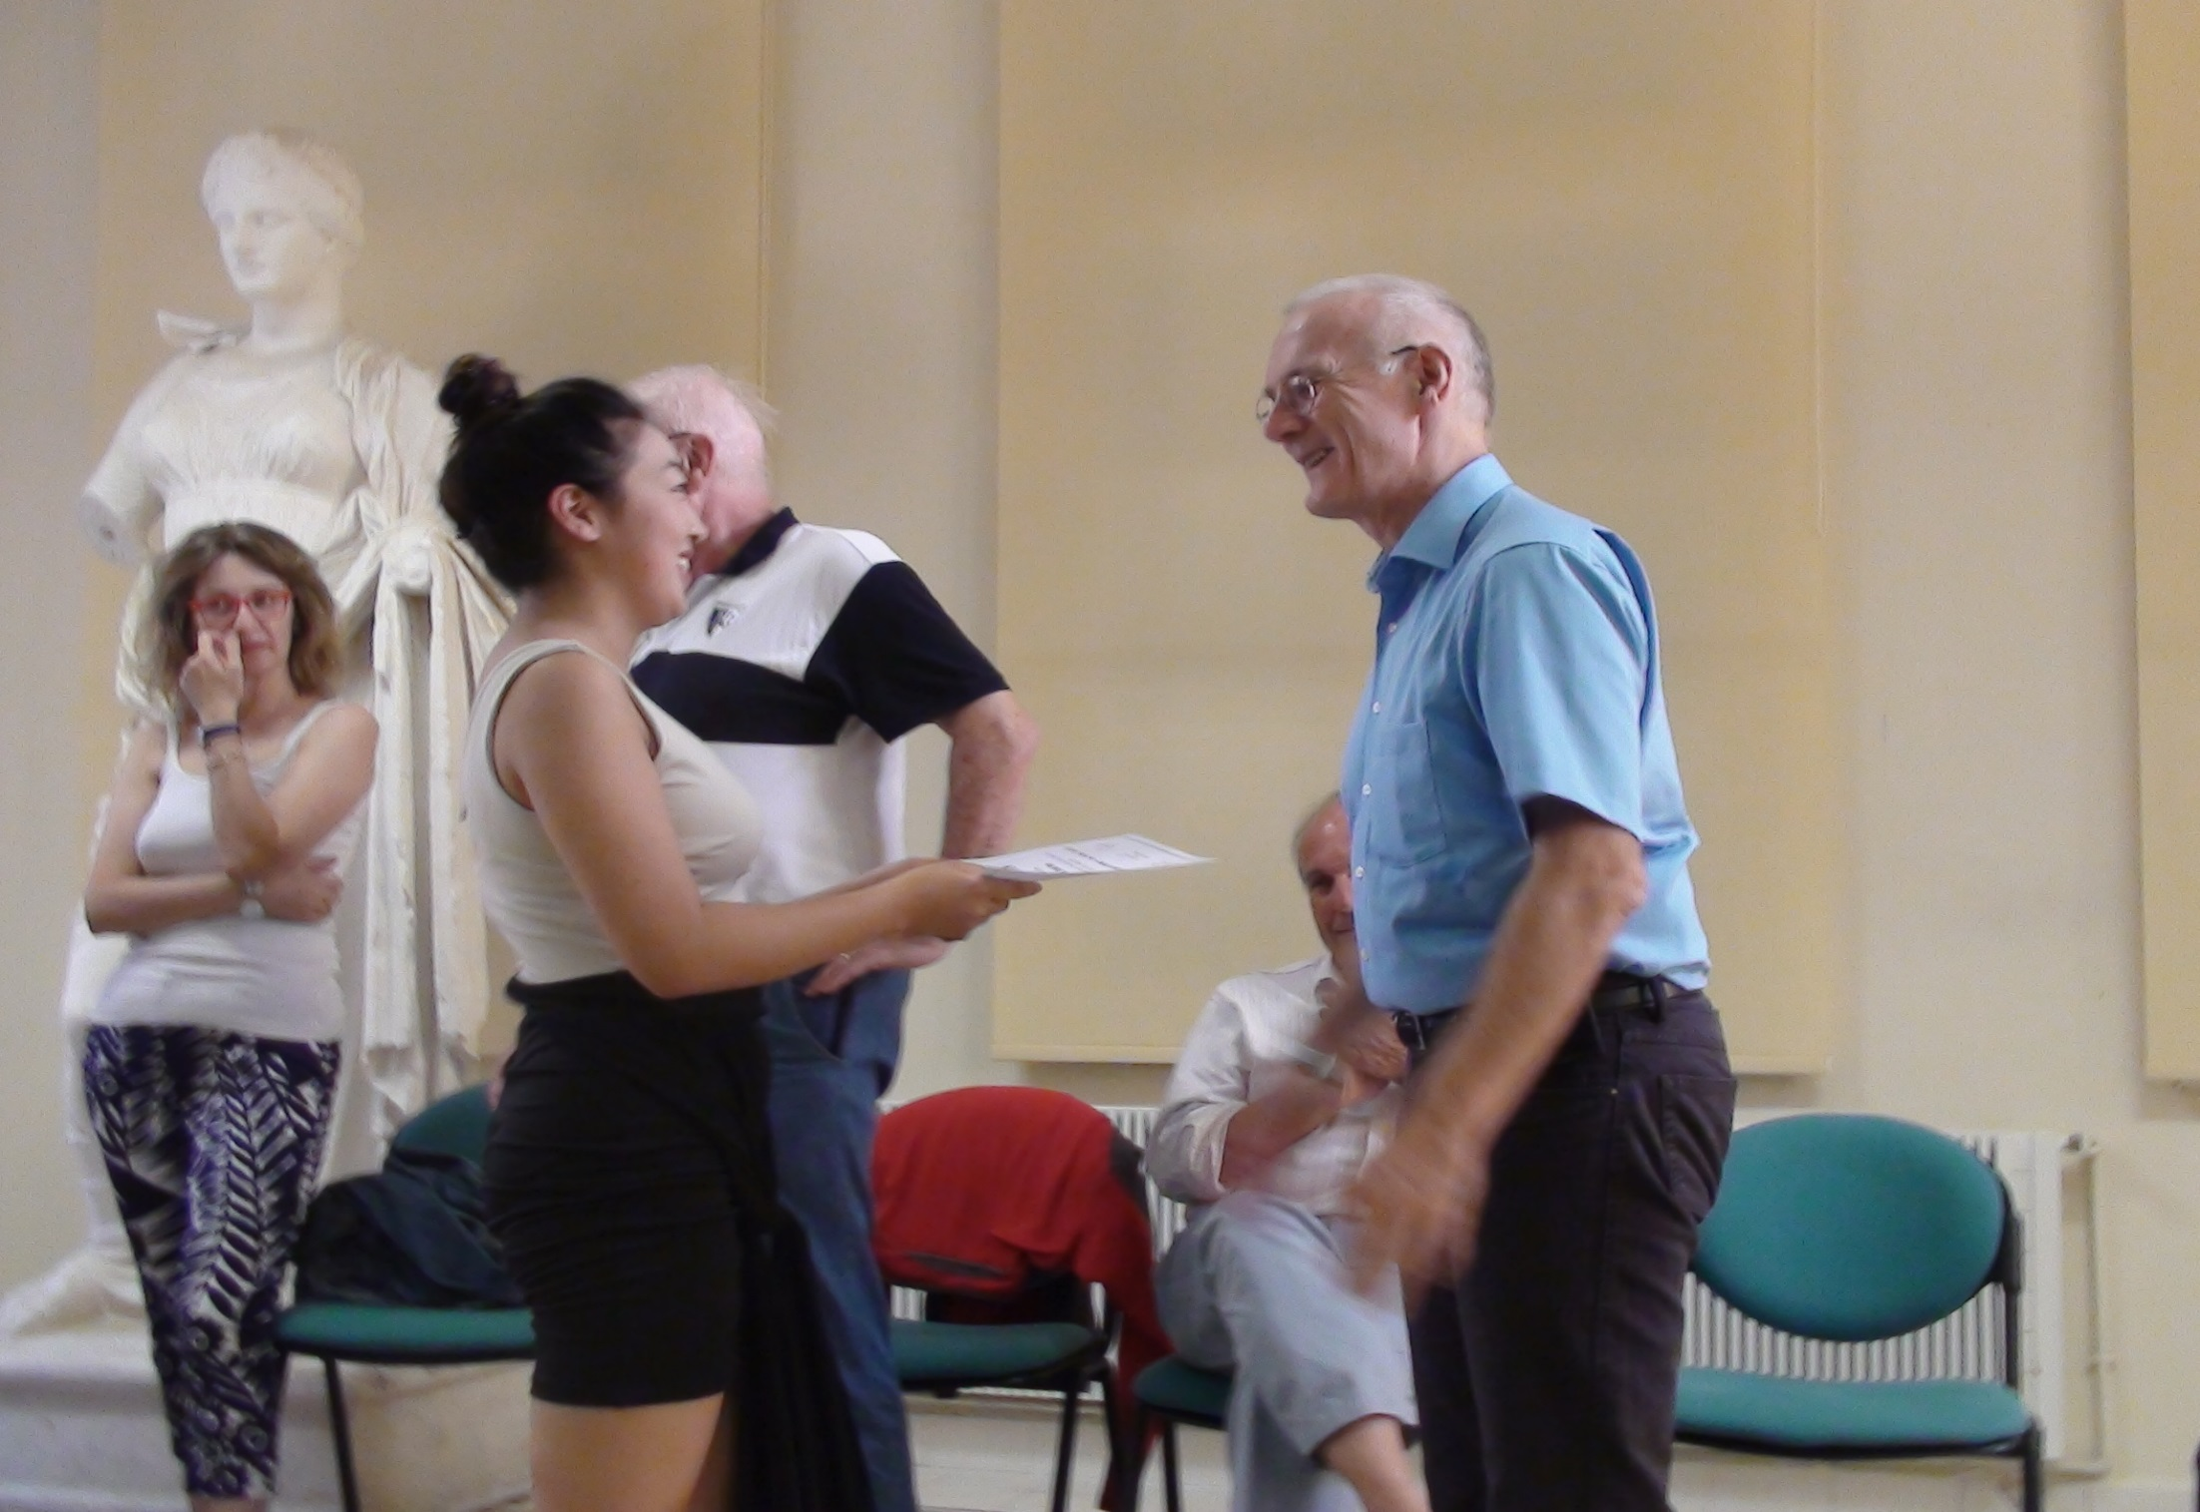
Certificates

Slide 11
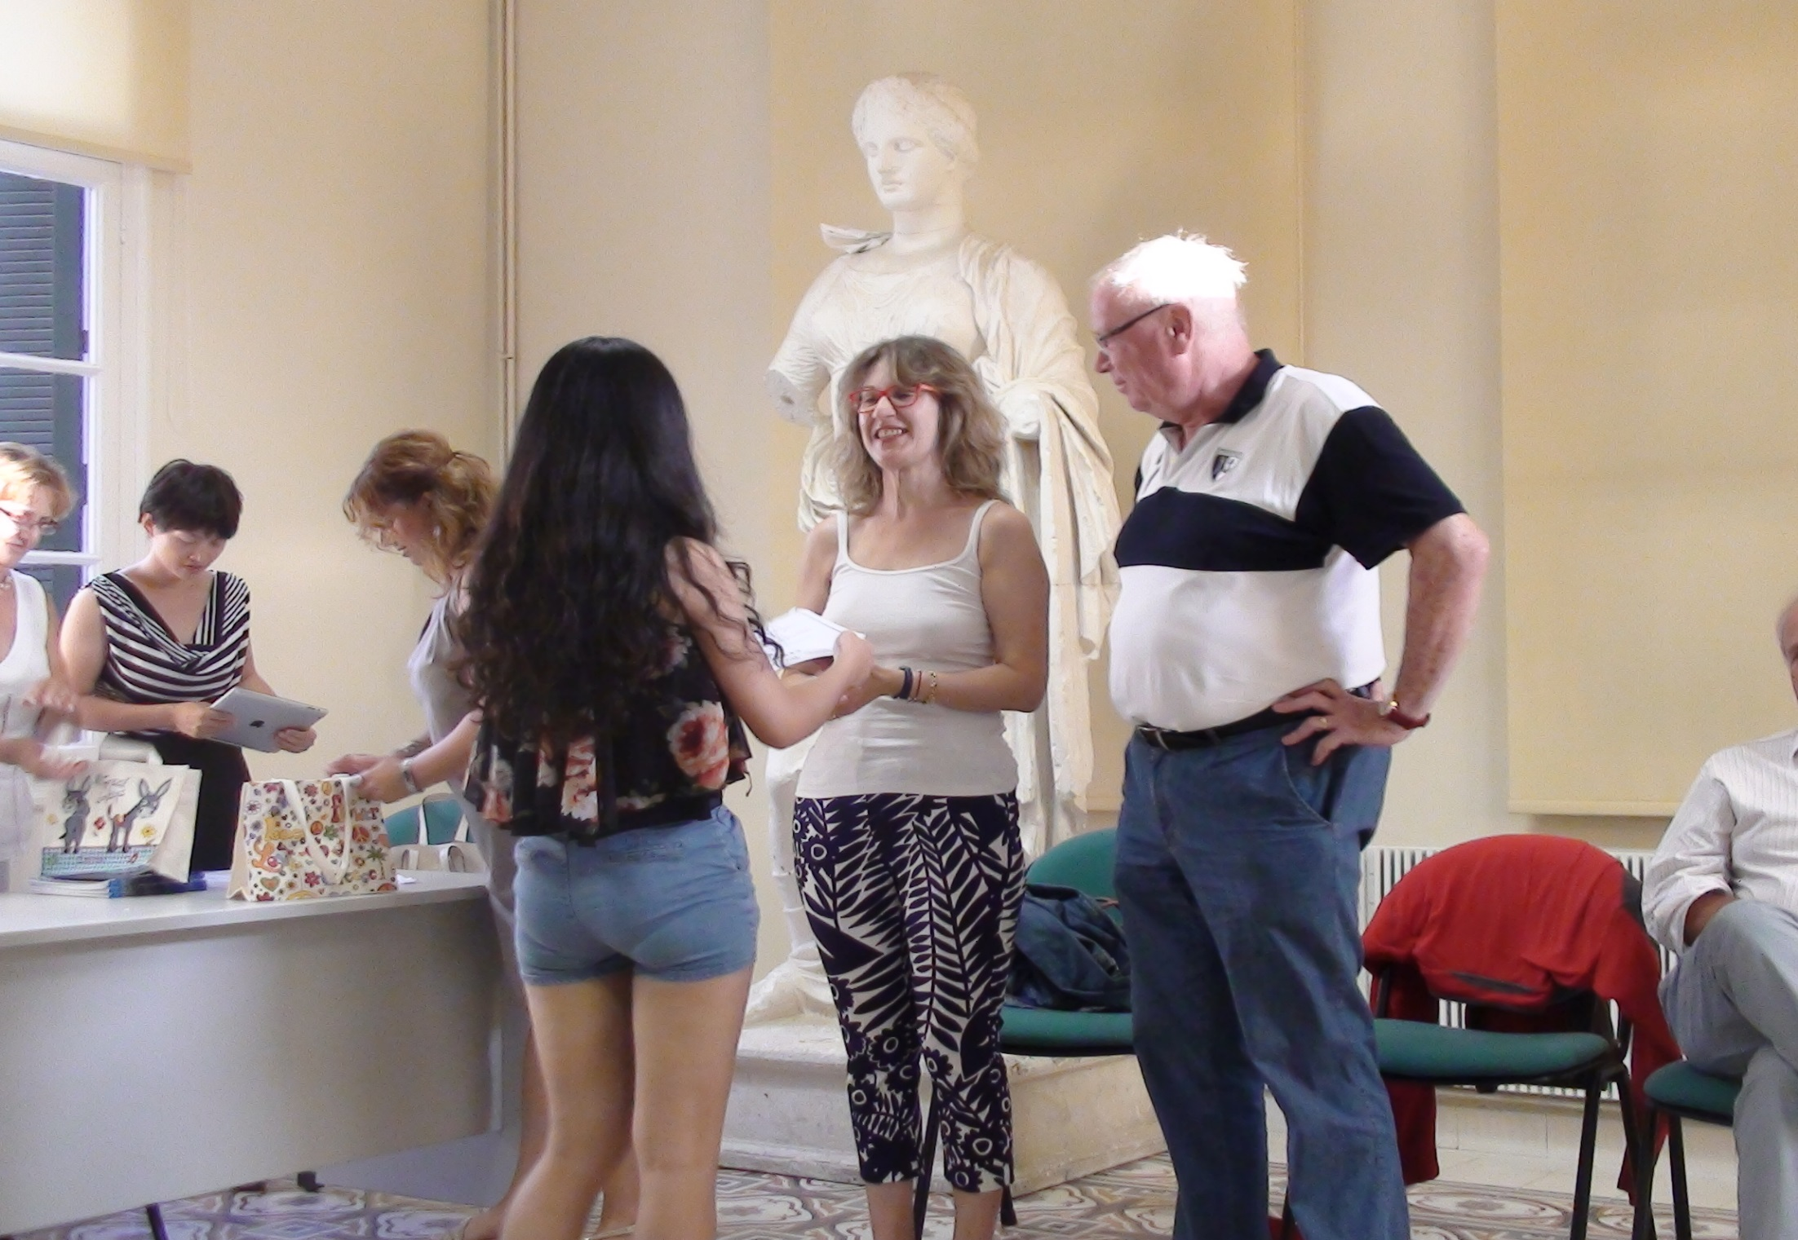
Certificates

Slide 12
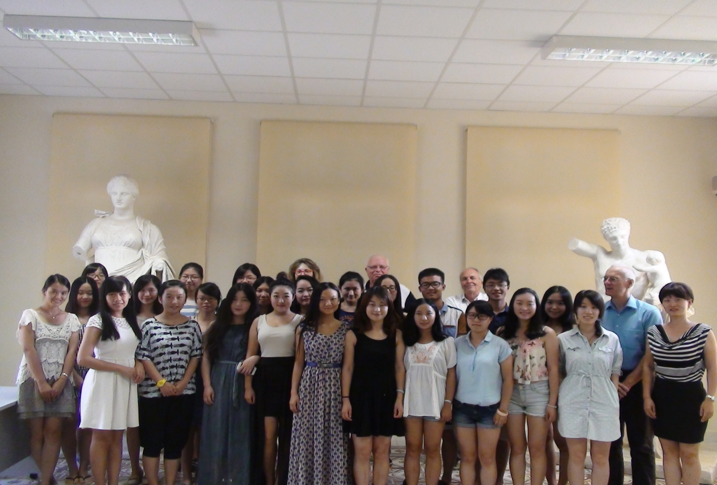
Certificates

Slide 13
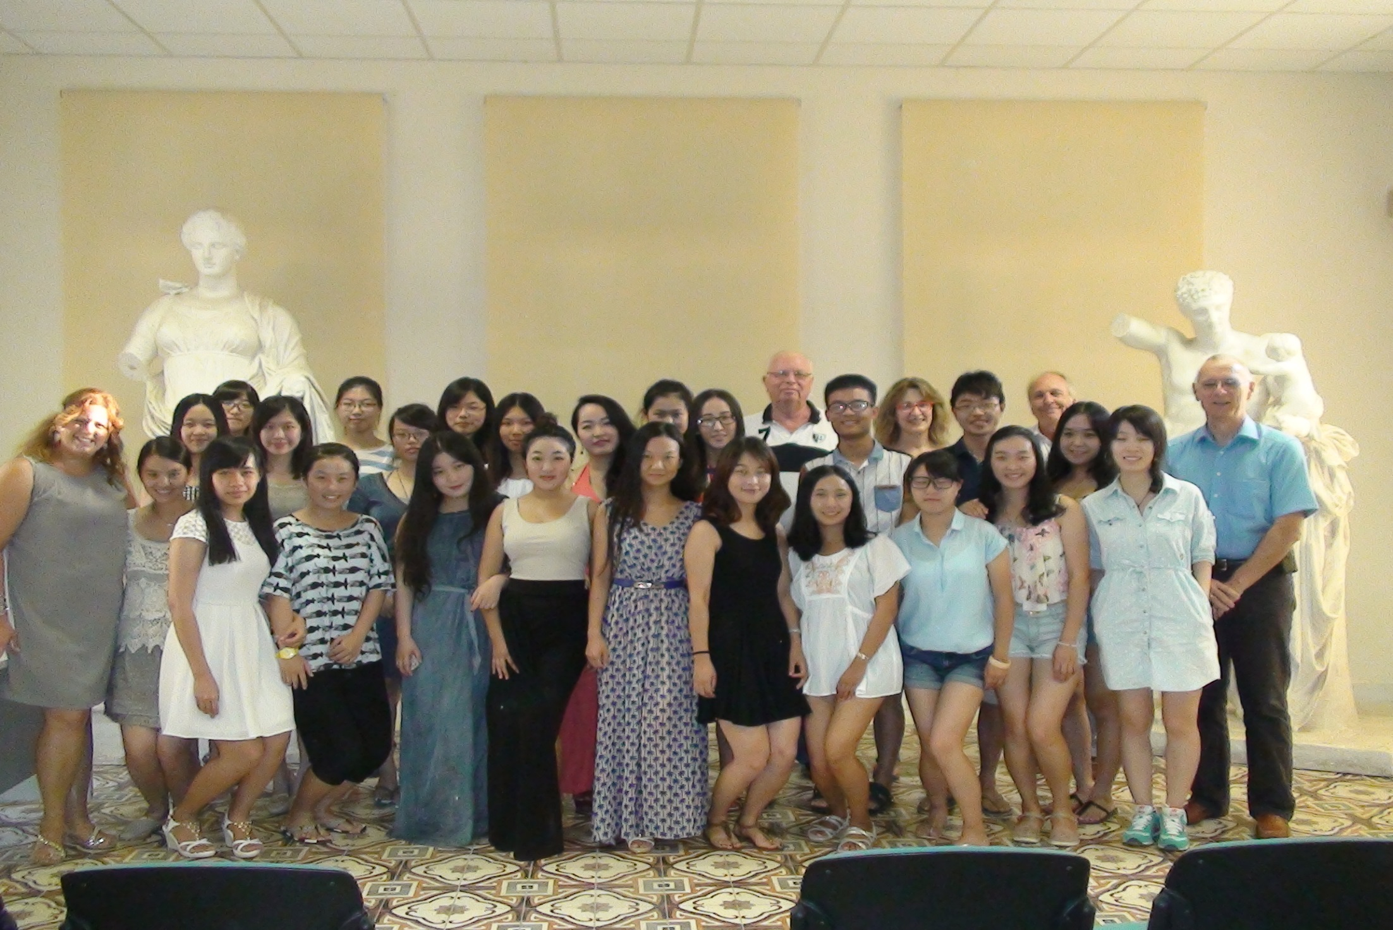
Certificates

Slide 14
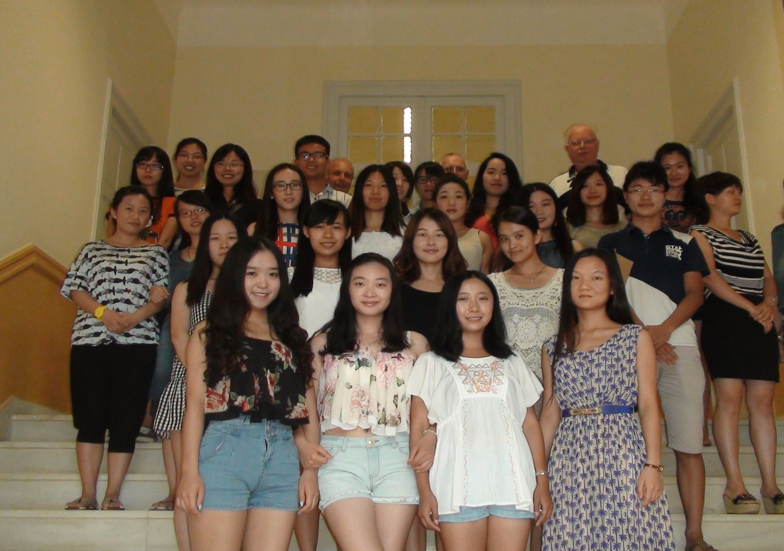
Certificates

Slide 15
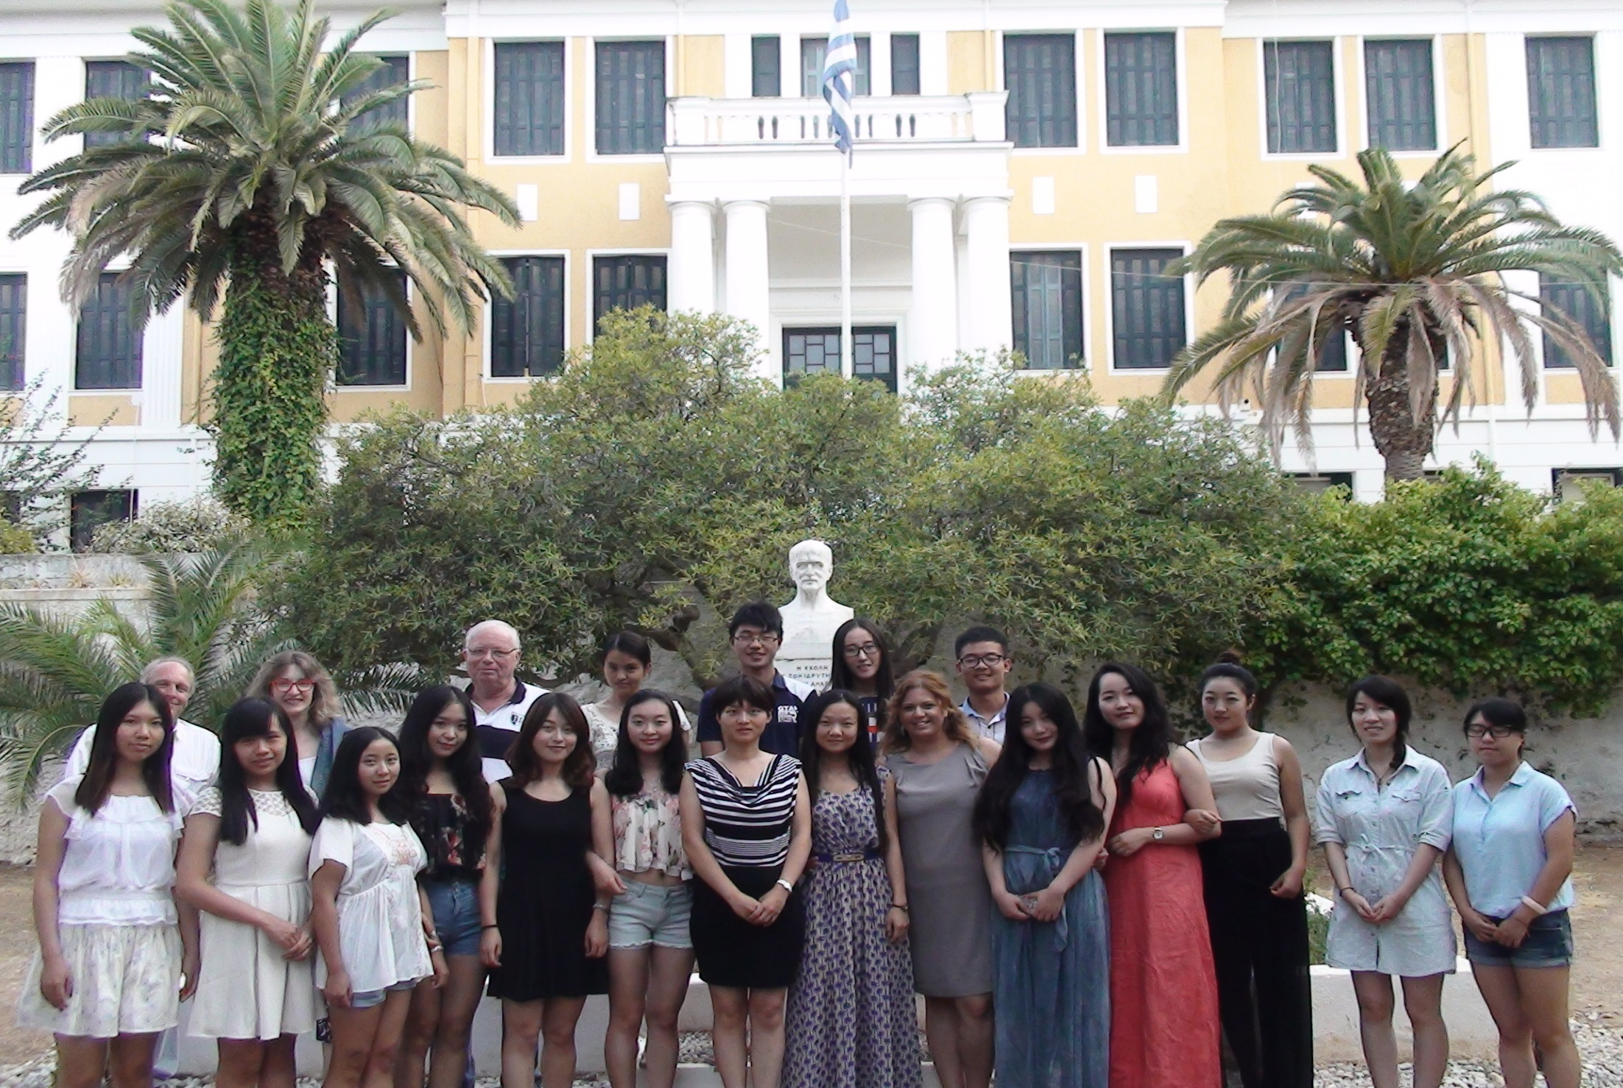
Certificates:
Outside AKSS

Slide 16
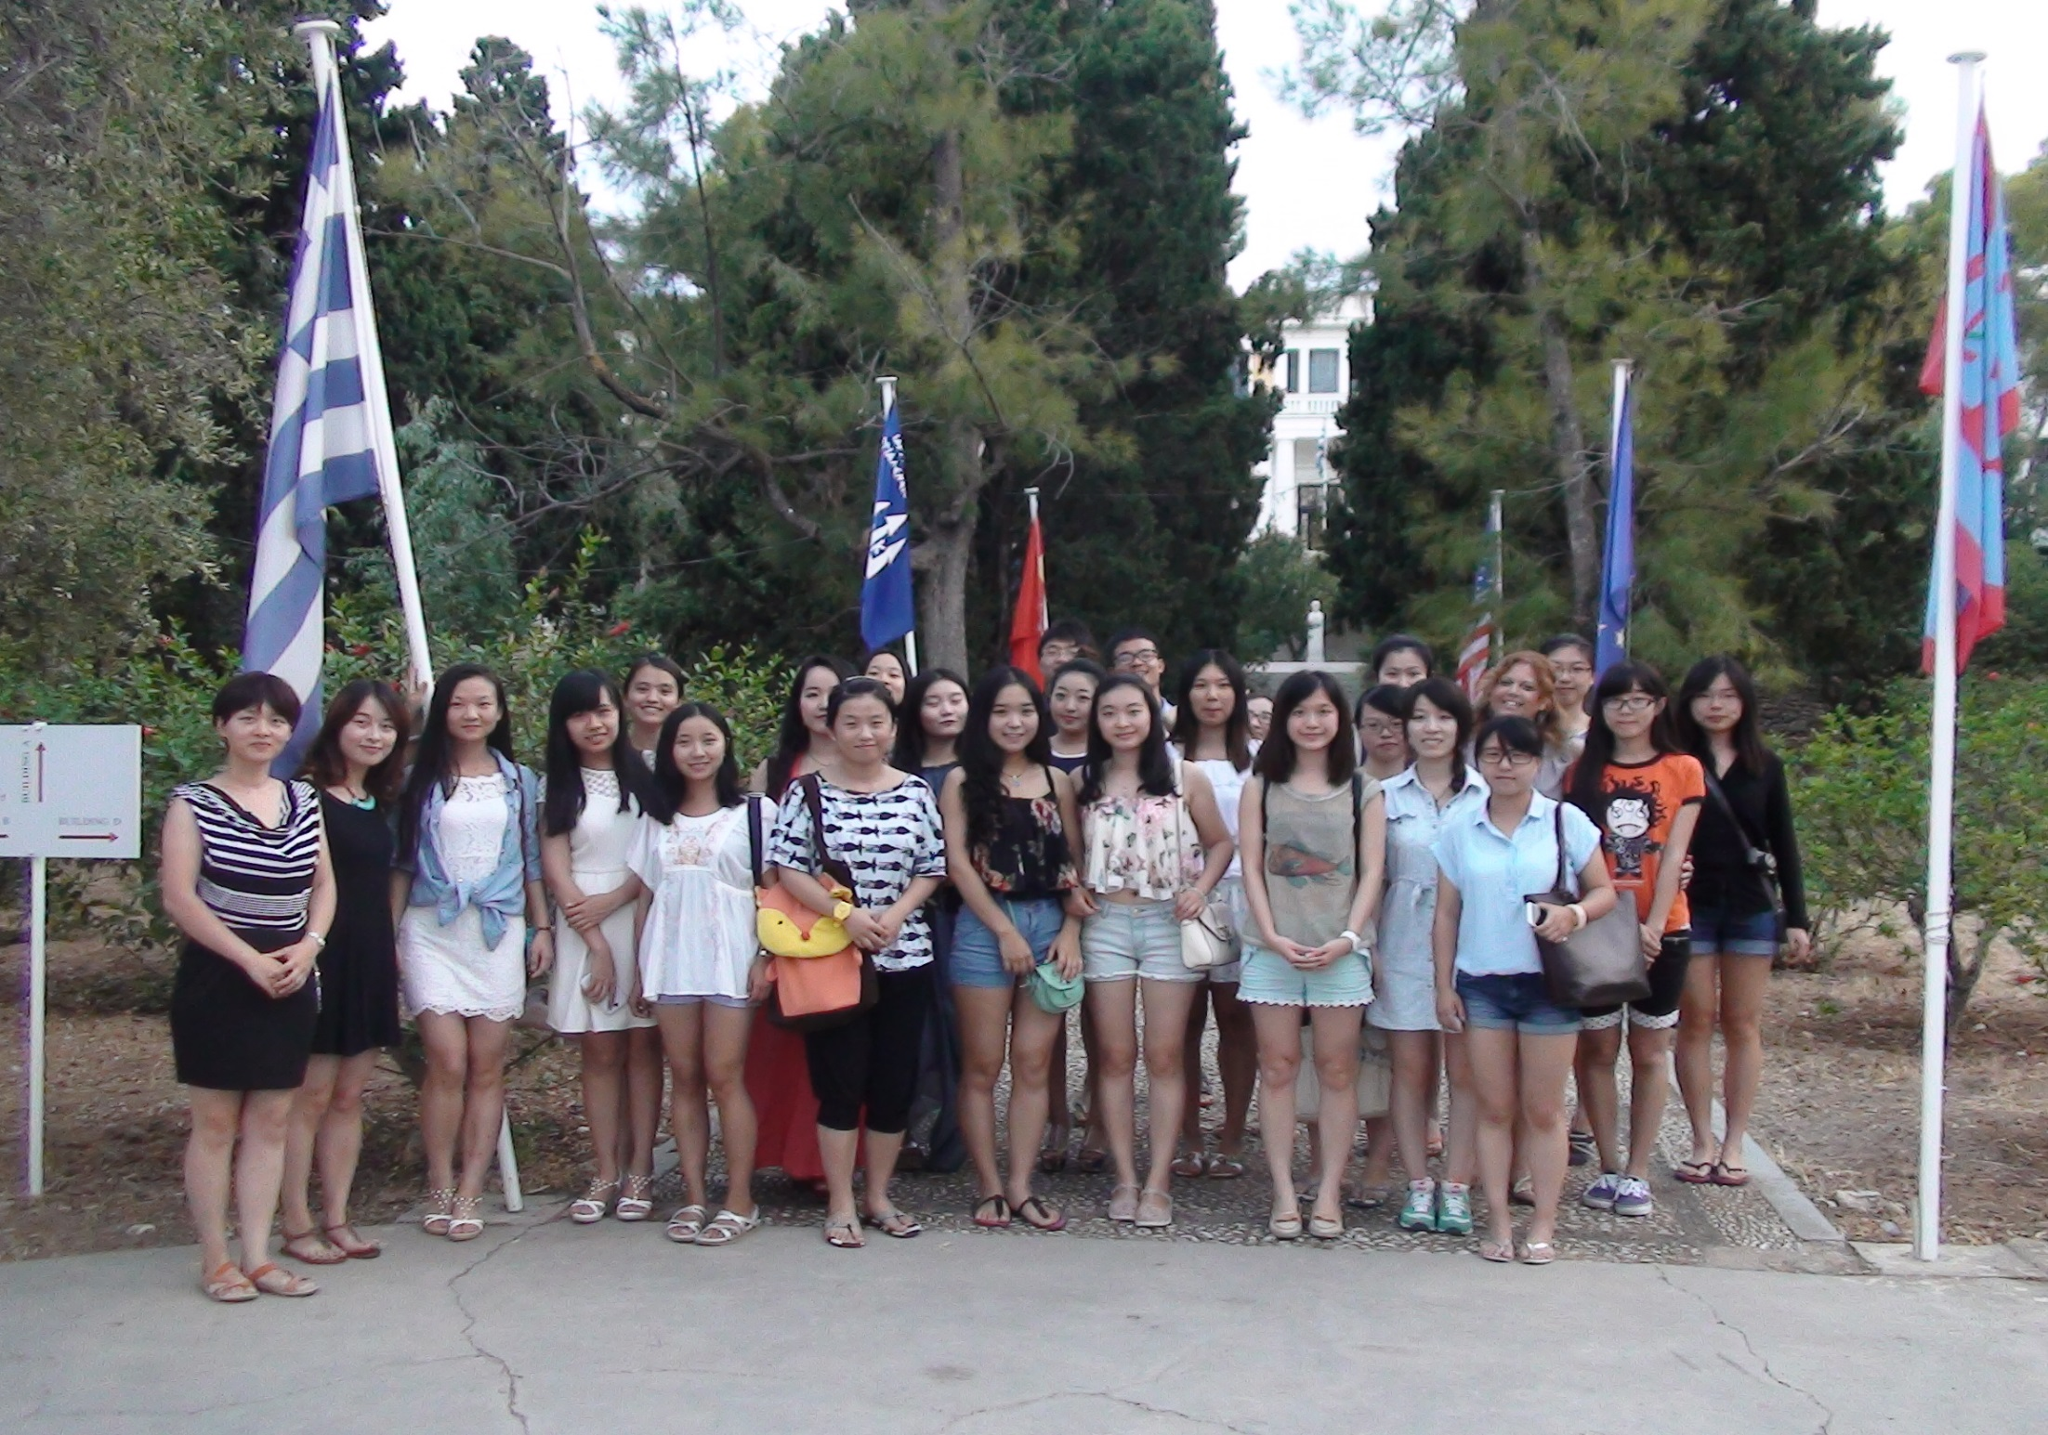
Certificates:
Outside AKSS

Slide 17
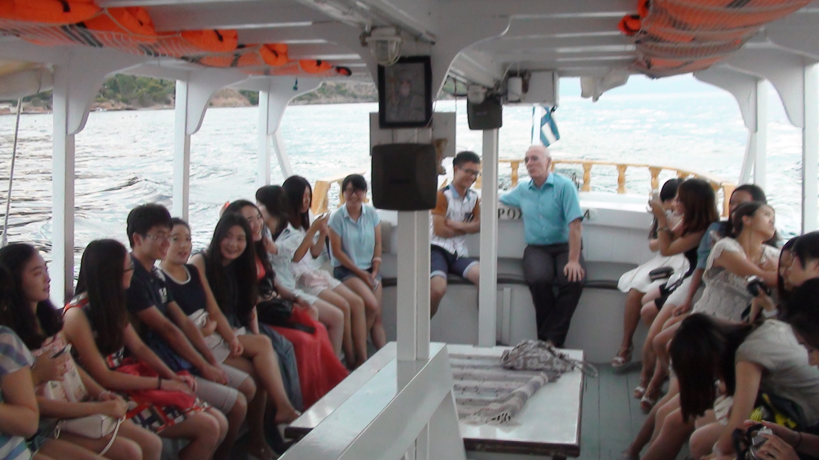
On our way for the farewell dinner on Spetses Island

Slide 18
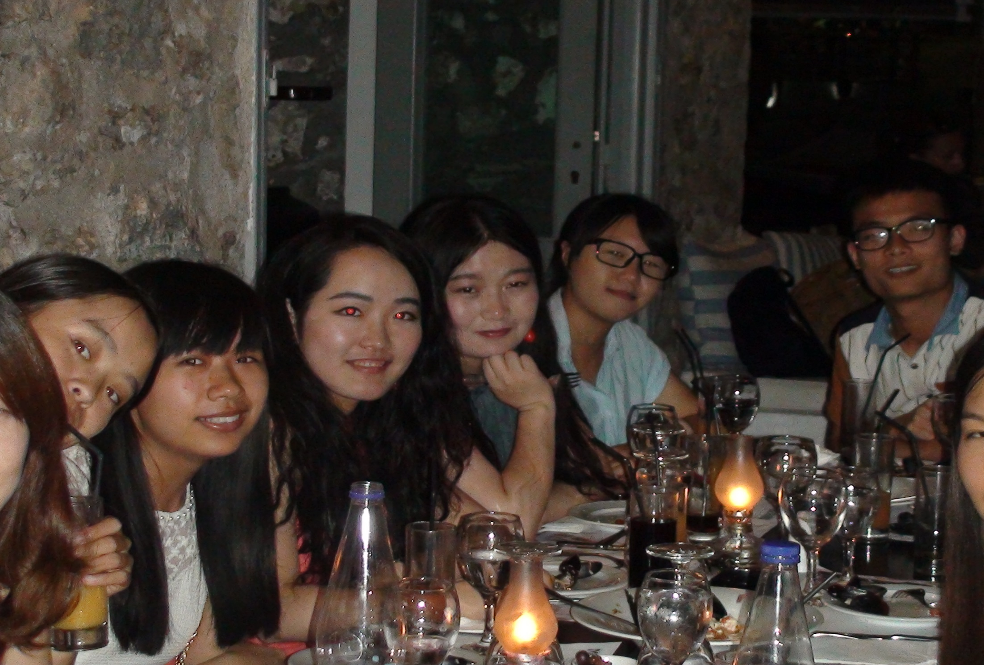
Farewell dinner on Spetses Island

Slide 19
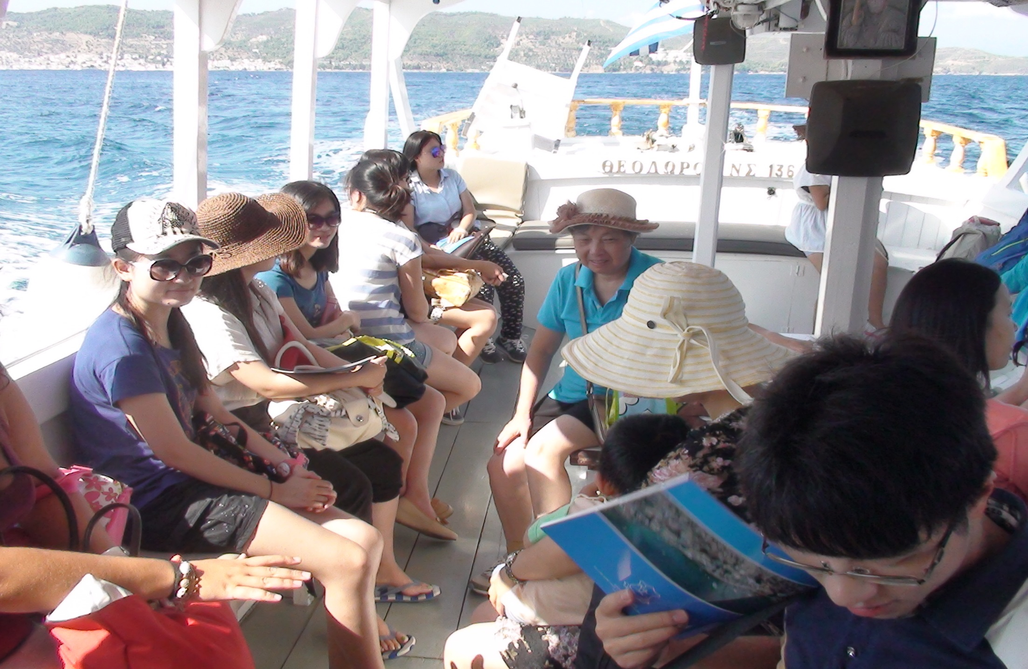
Living Spetses Island

Slide 20
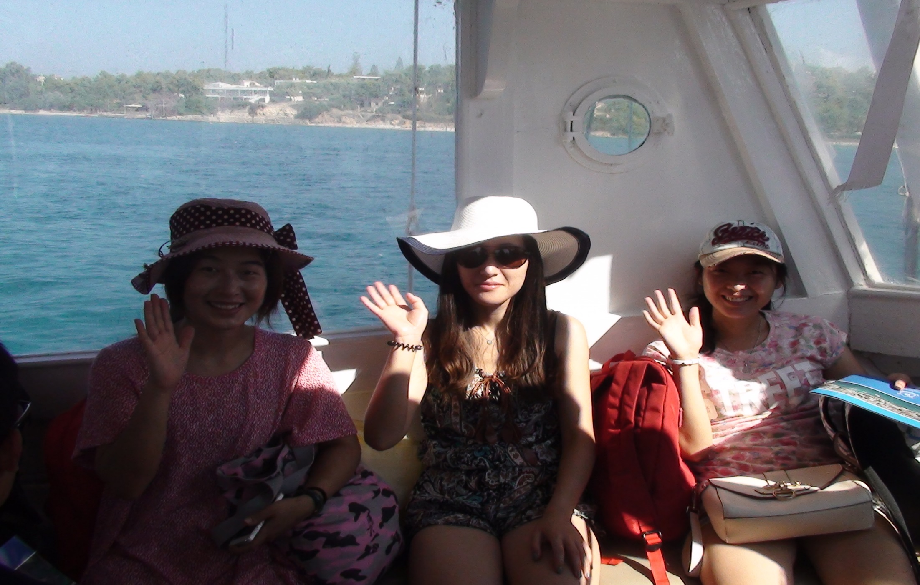
Living Spetses Island

Slide 21
The End for 2014

